Slide 1
Exploratory Data Analysis
Created by
Nobel Barua

Slide 2
Data Name: Bank risk defaulter analysis
Two data set
1)Application Data-Initial shape-(307511, 122)
2)Previous Data-Initial shape-(1670214, 37)
Tools used: Python, jupyter notebook, pandas, matplotlib, seaborn
Method:Exploratory Data anlysis

Slide 3
Null value percentage
Previous Data(11 attributes show more than 40% null value )
Application Data( 49 column have more than 40% null values )
Attribute removing strategy: attributes which has more than 40% null value
And attribute has only one unique values, data and business underatstanding the relation between target and feature, and corelation with target and feature with heat map

Slide 4


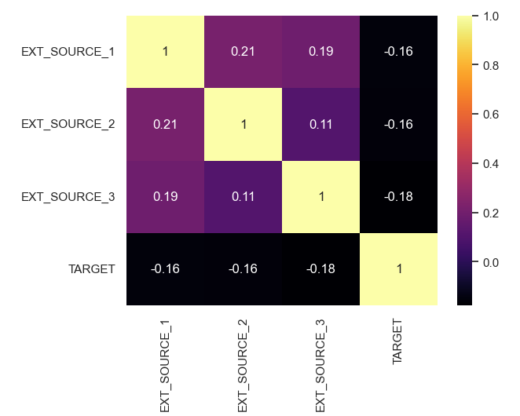
Selecting unwanted column(AD)
Correlation analysis
Insight: From this heatmap analysis we can see there is no correlation with ext. source and target , where we see Ext source 1 has 56%null value and 3 has 19.2%
There is no relationship between Target and all Ext source

Slide 5
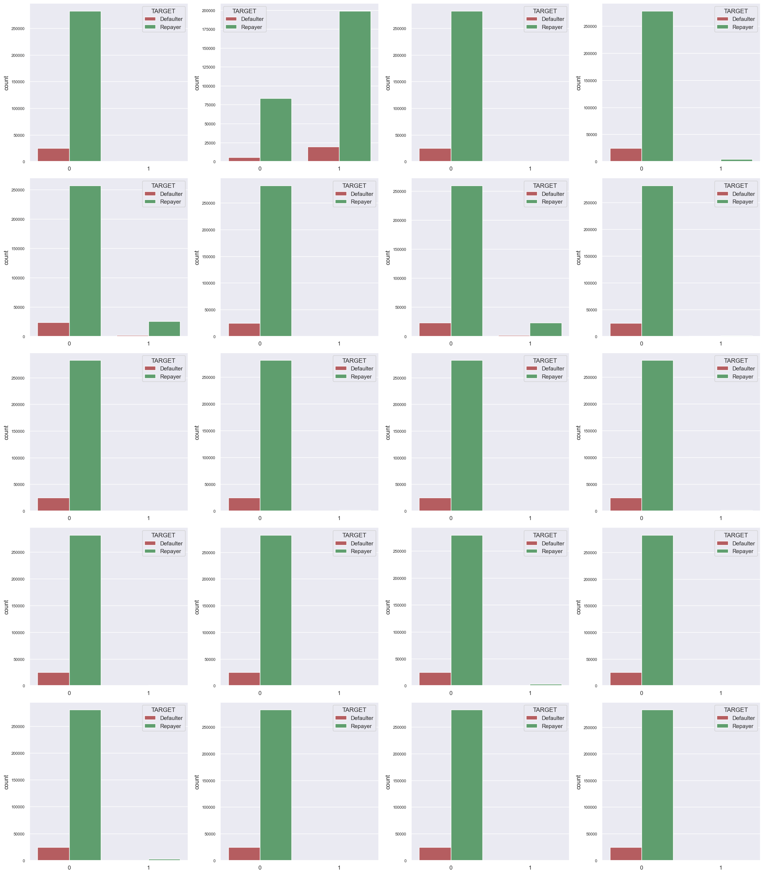
Selecting unwanted column(AD)
Insight: The count plot shows that in most of the loan application cases, clients who applied for loans has not submitted FLAG_DOCUMENT_X except FLAG_DOCUMENT_3. Thus, Except for FLAG_DOCUMENT_3, we can delete rest of the columns.
Plot also shows if borrower has submitted FLAG_DOCUMENT_3 then there is a less chance of defaulting the loan.

Slide 6
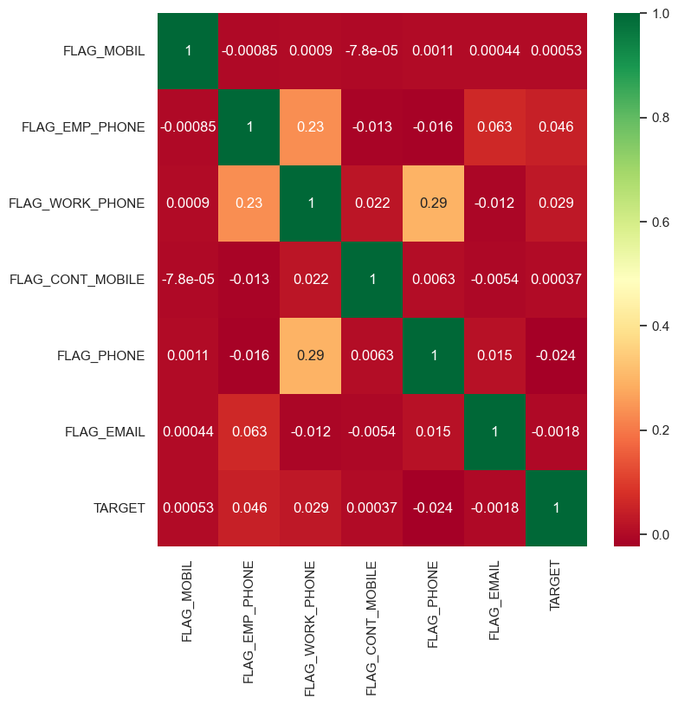
Selecting unwanted column(AD)
There is no correlation among Contact variable like 'FLAG_MOBIL','FLAG_EMP_PHONE','FLAG_WORK_PHONE','FLAG_CONT_MOBILE','FLAG_PHONE','FLAG_EMAIL','TARGET’ And Target
So, we can remove the contact attribute

Slide 7
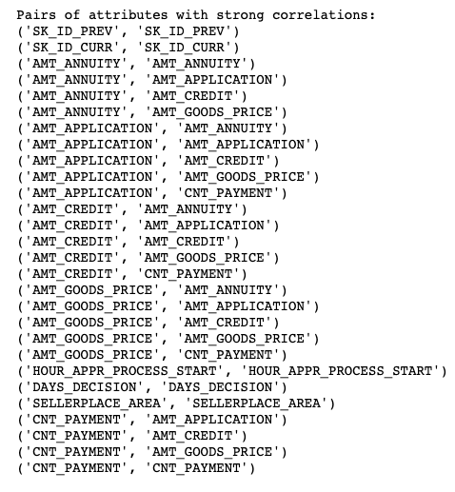
Selecting unwanted column(PD)
In null percentage filtering , found 11 attribute more than 40%
An in-correlation analysis , found attribute like AMT_annuity,AMT_application, AMT_credit,AMT_good price have strong relationship among them, so we keep it
From other existing variable we found have unique value() and others variable like () have no relation with target(guess by business understanding)
So we remove in total 15 attribute from previous data

Slide 8
The dataset shape after removing uwanted column
Removing unwanted column(Application Data(122-76)),(Previous Data(37-15))
After removed
Application Data(307511, 46)
Previous data(1670214, 22)

Slide 9
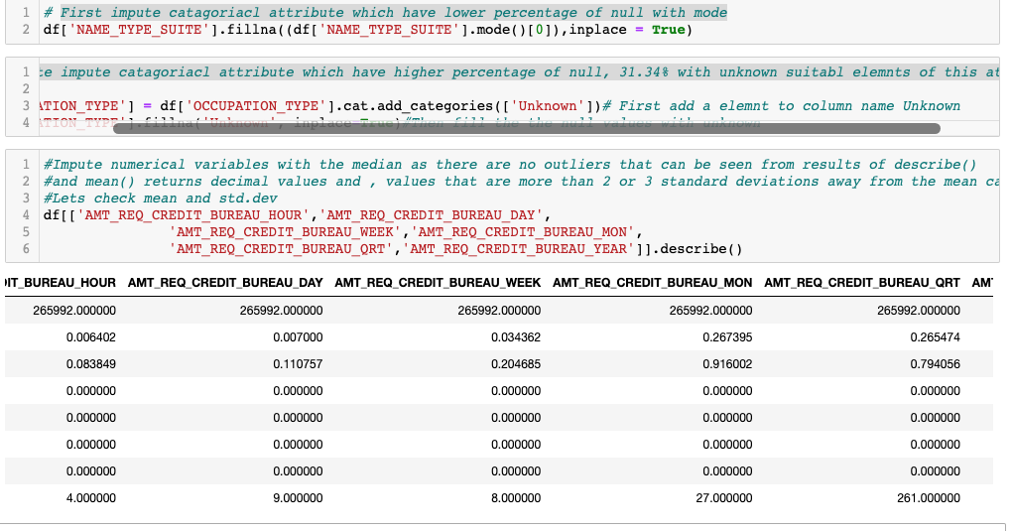
Imputation
Different Imputation strategy taken(Aplication data)
For Continous variable
1)As there is no outliar , all the attribute std.dev is 0, so it suggest there is no outliar , so we can change the null value with median
For catagorical variable
1)First impute categorical attribute which have lower percentage of null with mode
2) 2nd impute categorical attribute which have higher percentage of null 31.34% with unknown, suitable elements of this attribute

Slide 10
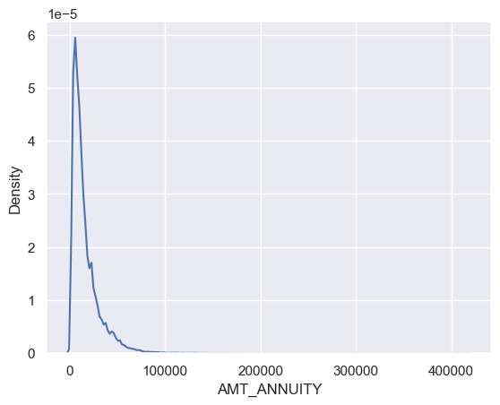
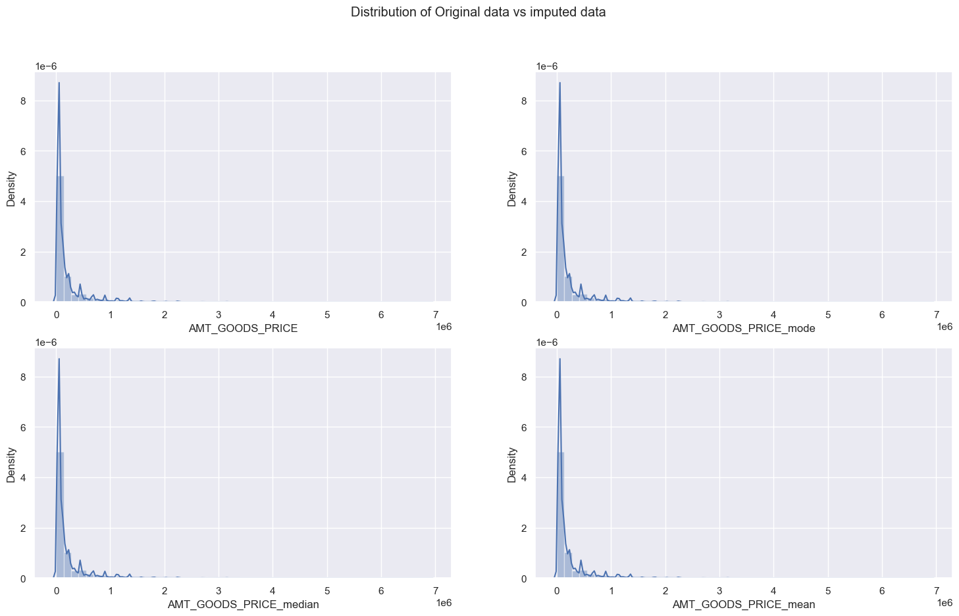
Imputation
Different Imputation strategy taken(Previous data)
For Continous variable
1) we see AMT_annuity is positively skewed means there is outlier, so mean is not appropriate (its can be affects by outlier). median would be good
2) we can see that the AMT_good price without imputation is almost like mode and median strategy, we chose median
3) CNT_payment counts and the occurrences of each unique 'NAME_CONTRACT_STATUS' value for the rows where 'CNT_PAYMENT' is null , as most of the contact status refused and cancelled , so there is no pay mint, so we can change these NAN value with 0

Slide 11
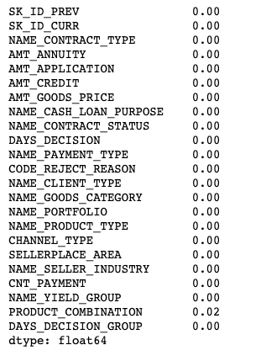
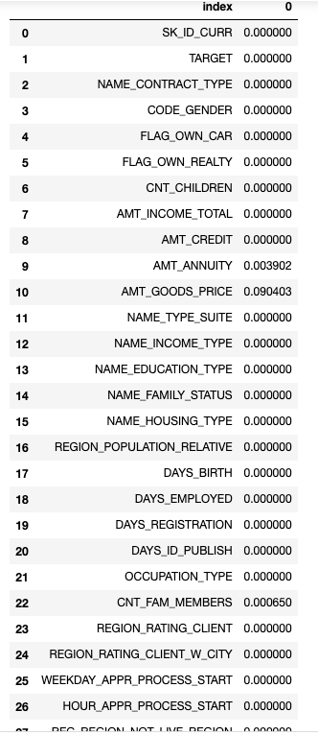
After imputation null percentage
Sample image of null percentage of Previous Data atributes
Sample image of null percentage of AplicationData atributes
Note:the least percentage of null we can ignore

Slide 12
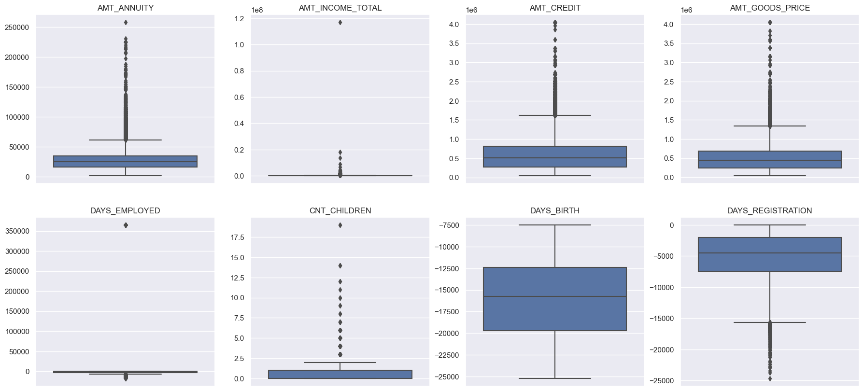
Outliar Analysis
1)Application Data
'AMT_ANNUITY',AMT_CREDIT','AMT_GOODS_PRICE',' and CNT_CHILDREN have some number of outlier ,Days of birth have no outlier, Days, employed huge outlier that is over 35000, its around 958 years, its impossible Days of registration have few outliers

Slide 13
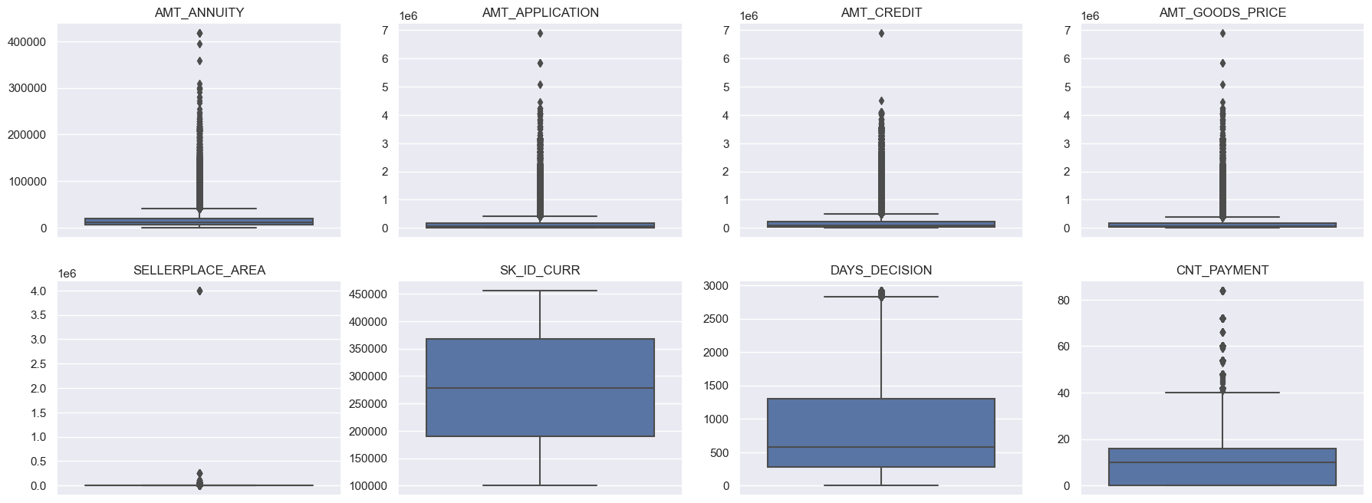
Outliar Analysis
1)previous Data
'AMT_ANNUITY','AMT_APPLICATION','AMT_CREDIT','AMT_GOODS_PRICE','SELLERPLACE_AREA', have several outliers than others seller place area few, sk_id have no outlier And CNT payment has some few outliers

Slide 14
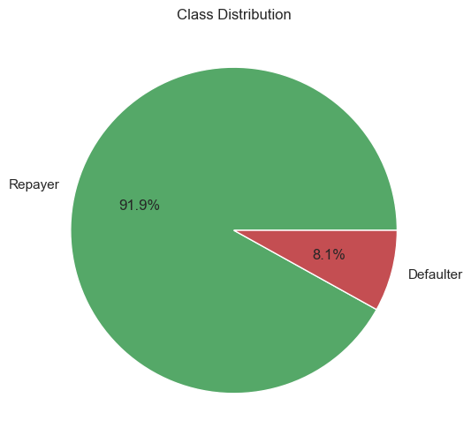
Understanding Feature importance 1st-aplication data,2nd-Previos data
Checking for data imbalance
During EDA
Insight: Having a class distribution where one class represents 91.9% of the data and the other class represents the remaining percentage indicates a severe class imbalance. It is crucial to handle this imbalance appropriately during data pre-processing, model training, and evaluation to ensure fair and accurate predictions for both classes.

Slide 15
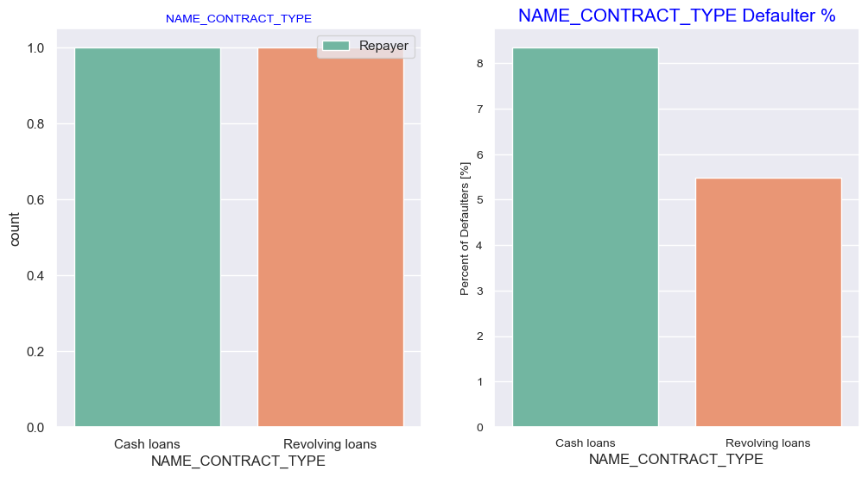
Percentage of Defaulters with Target
Univariate Analysis with target variables
Insight:
The count of people in both categories Cash loans and revolving loans are same
But the people who take the cash loans which have higher risk of defaulter(more than 8%) than revolving loans(around 5.5%)

Slide 16
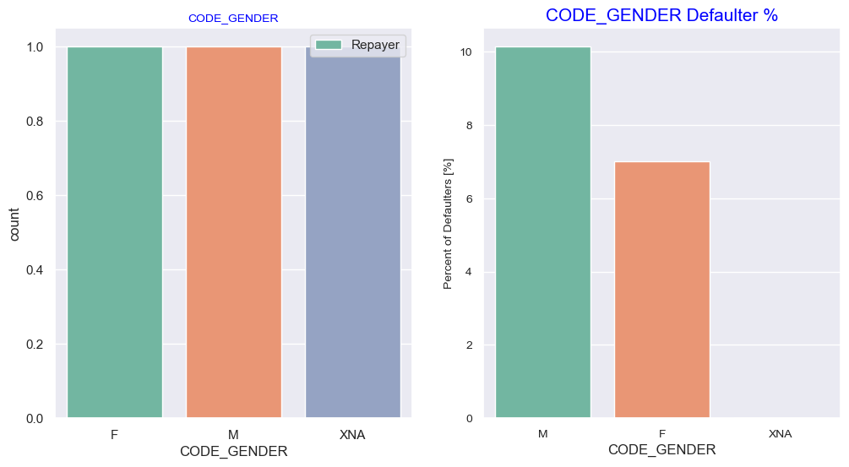
Gender and Risk deafuter relation
Insight:
Male have higher percentage more than 10% of risk than female more than 6% defaulting risk, where XNA have no info

Slide 17
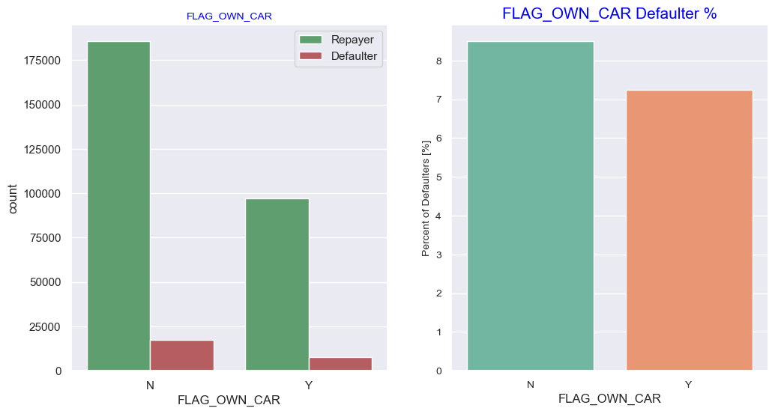
Owning car and relation with Default risk
Insight
Clients who own a car are half in number of the clients who don't own a car. But based on the percentage of default analysis, there is no significant correlation between owning a car and loan repayment as in both cases the default percentage is almost same.

Slide 18
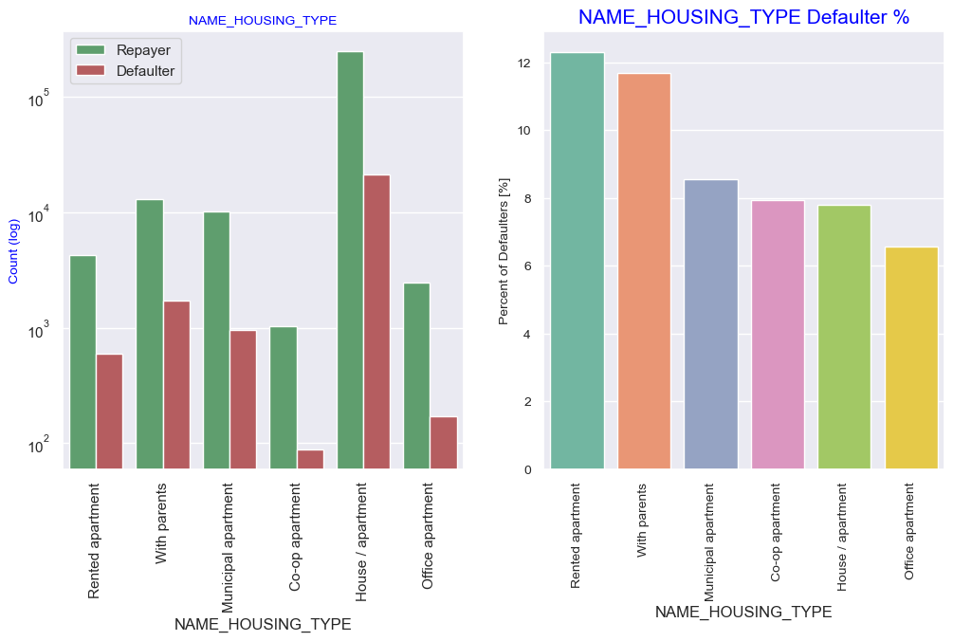
customer housing type and default risk
Inferences:
Majority of customer who live in House/ apartment and People living in office apartments have lowest default rate around 8% and around 6.2% respectively
People living with parents (~11.5%) and living in rented apartments(>12%) have higher probability of defaulting

Slide 19
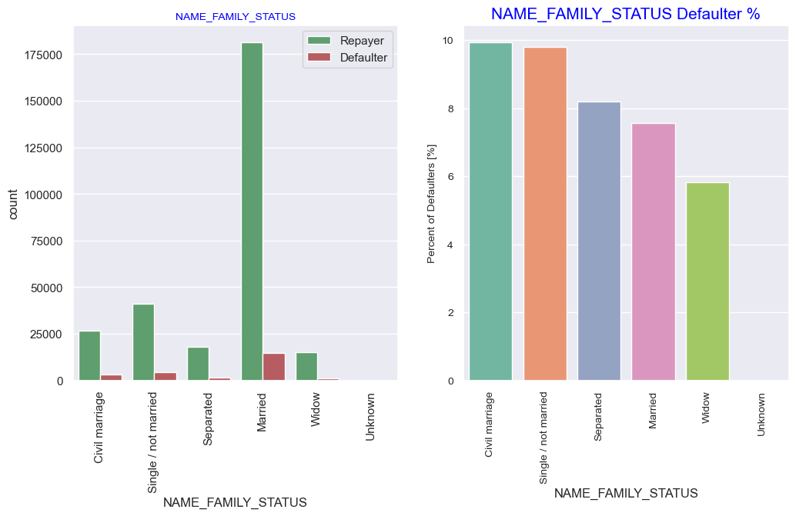
Family status and risk of default
Insight:
The people who are married are highest in loan applicant and repayer than other family status.
In % of risk defaulter analysis, presents that people who are civil marriage and single risk of defaulting around10%

Slide 20
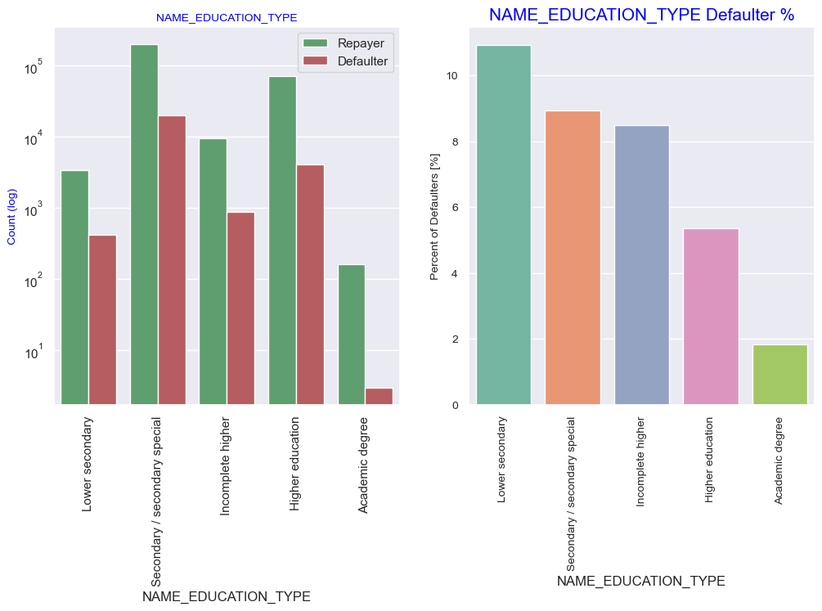
Education level and Risk of default
Insight:
The people who completed secondary education take more loan than the other education, And people who have lower education high defaulter than others, which represents more than 10%
And the people who competed secondary education are the 2nd highest defaulter around 8.5%
Where people with academic degree least default loan defaulter

Slide 21
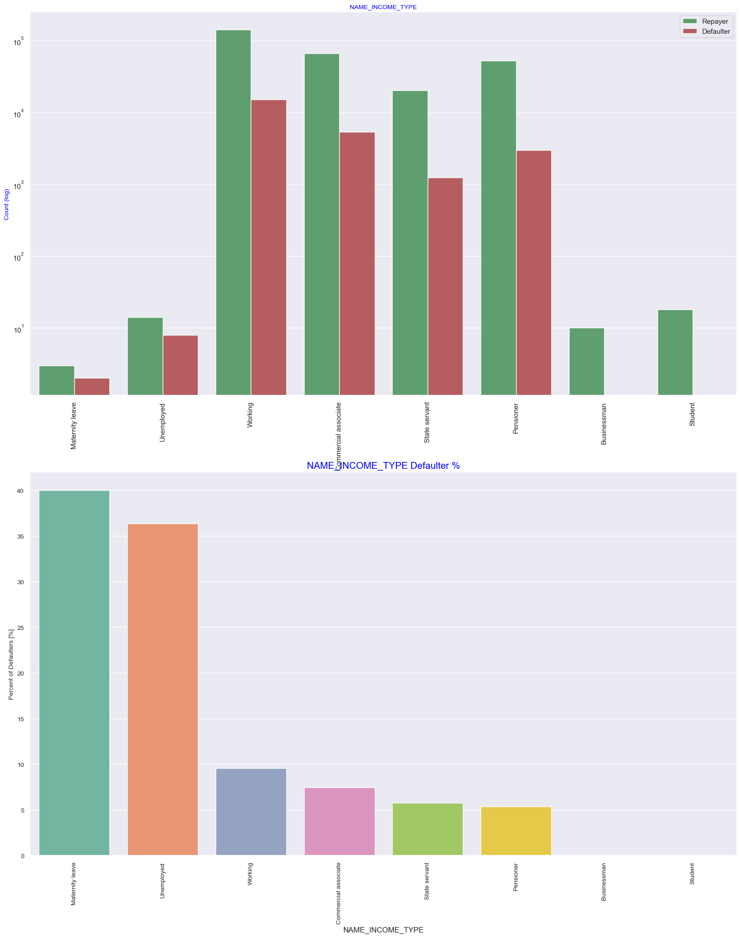
Income type and risk of default
Insight
Working people are more loan applicant than other income type people,
And the Maternity leave person almost 40% of risk of not returning loan, followed by Unemployed (37%). The rest of types of incomes are under the average of 10% for not returning loans.

Slide 22
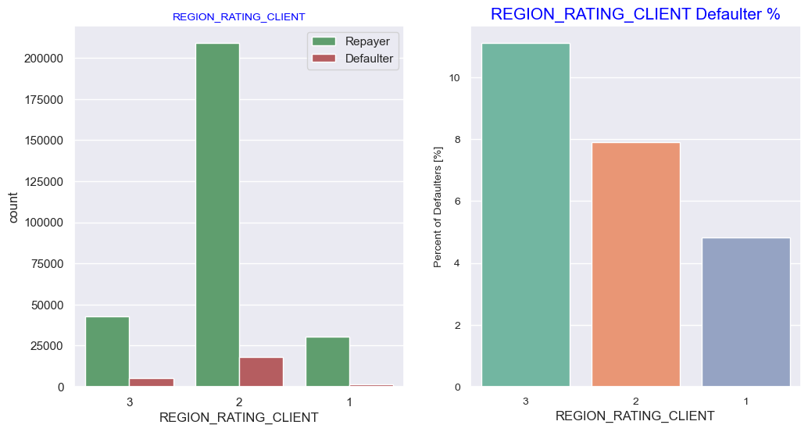
Region ratingsof appliacant and risk default
Insight:
Inferences: Most of the applicants are living in Region Rating 2 place. Region Rating 3 has the highest default rate around (11%) Applicant living in Region Rating1 (around 4.5%) has the lowest probability of defaulting, thus safer for approving loans

Slide 23
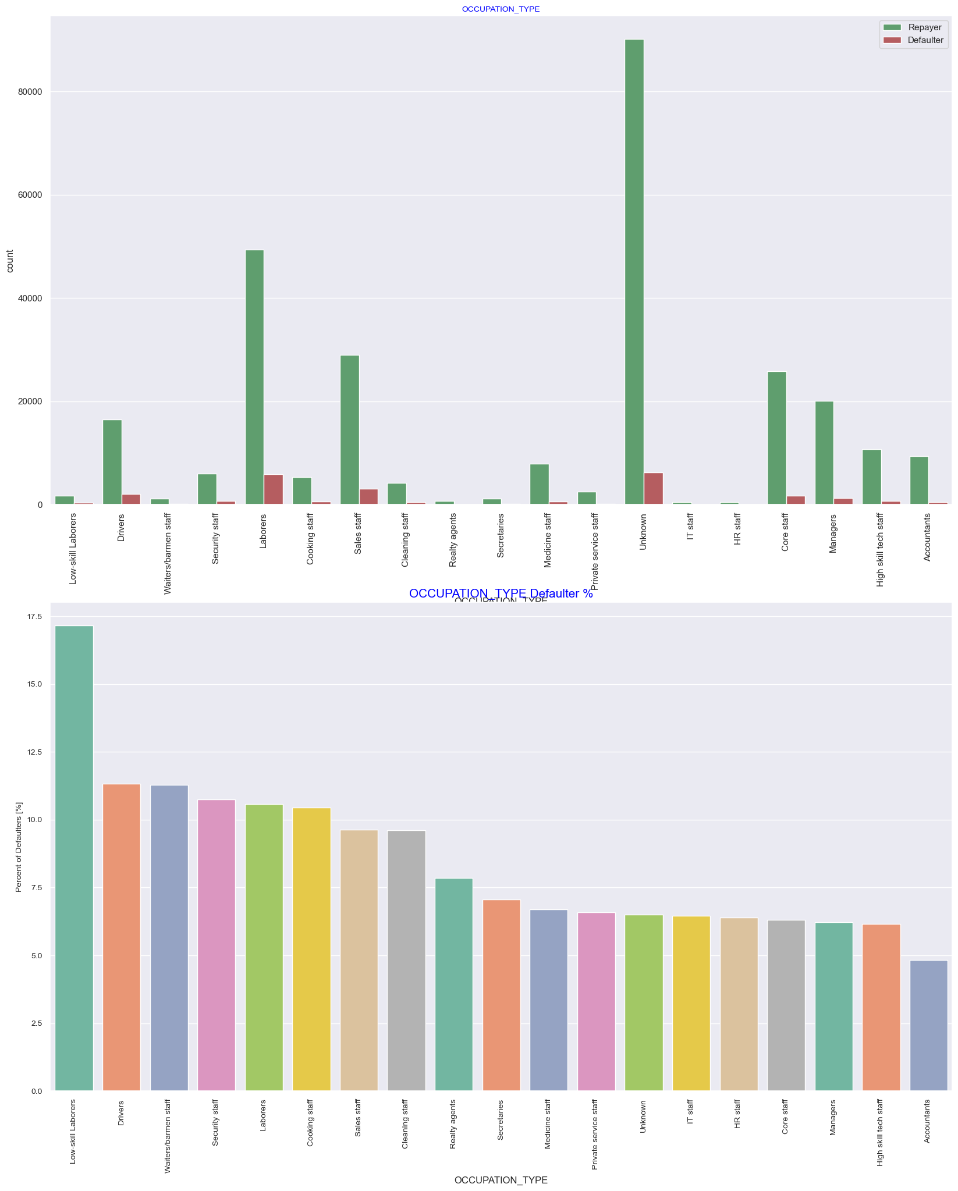
Occupation type and risk of default
Insight:
The unknown profession are most loan applicant than others known profession , followed by Laboure's people , who took the loan more than the other profession, where low skills labor around (around17%) whose defaulting risk higher than the others professional people
And accountant are lowest defaulter

Slide 24
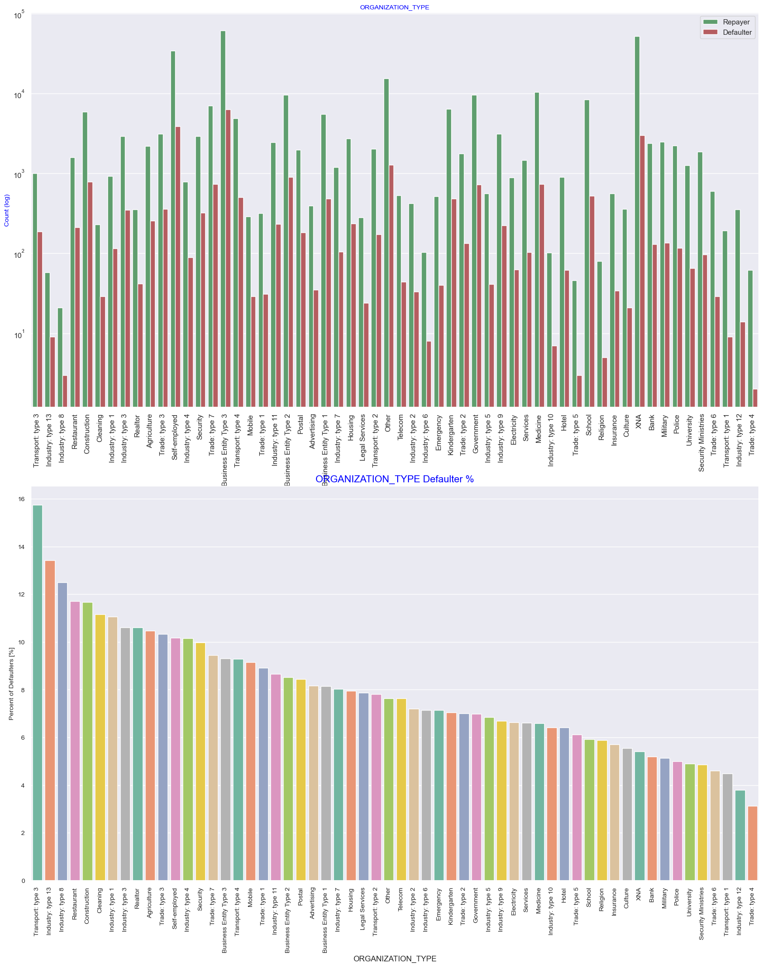
Organization type and risk default
Most of the people application for loan are from Business Entity Type 3, self-employed, Organization type information is unavailable(XNA) are very high number of applications
It can be seen that following category of organization type has lesser defaulters thus safer for providing loans:
Trade Type 4 and 5 Industry type 8 Self employed people have relative high defaulting rate, and thus should be avoided to be approved for loan or provide loan with higher interest rate to mitigate the risk of defaulting.
These represent risk by 12% to 16%

Slide 25
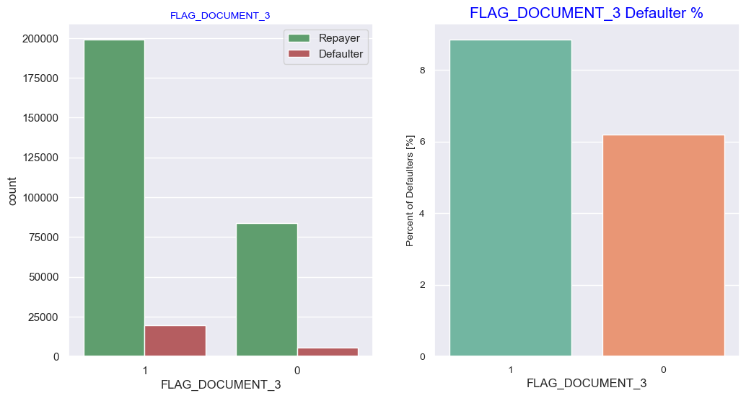
Flag document3 and Default risk
Insight:
The people who submit flag document _3 higher than the people who don't submit, There is no significant correlation between repayors and defaulters in terms of submitting document 3
as we see even if applicants have submitted the document, they have defaulted a slightly more (~9%) than who have not submitted the document (6%)
So documenting the document can be important risk identifier

Slide 26
Risk analysis with catagorical variables in Aplication Data
Address rrelated variables list
WEEKDAY_APPR_PROCESS_START REG_REGION_NOT_LIVE_REGION 28 REG_REGION_NOT_WORK_REGION 29 LIVE_REGION_NOT_WORK_REGION 30 REG_CITY_NOT_LIVE_CITY 31 REG_CITY_NOT_WORK_CITY 32 LIVE_CITY_NOT_WORK_CITY
Noted: Analysed those categorical variables with target variable , and concluded that that there is no significant relation between those address related variable and target, so in building our model we an omit this variables

Slide 27
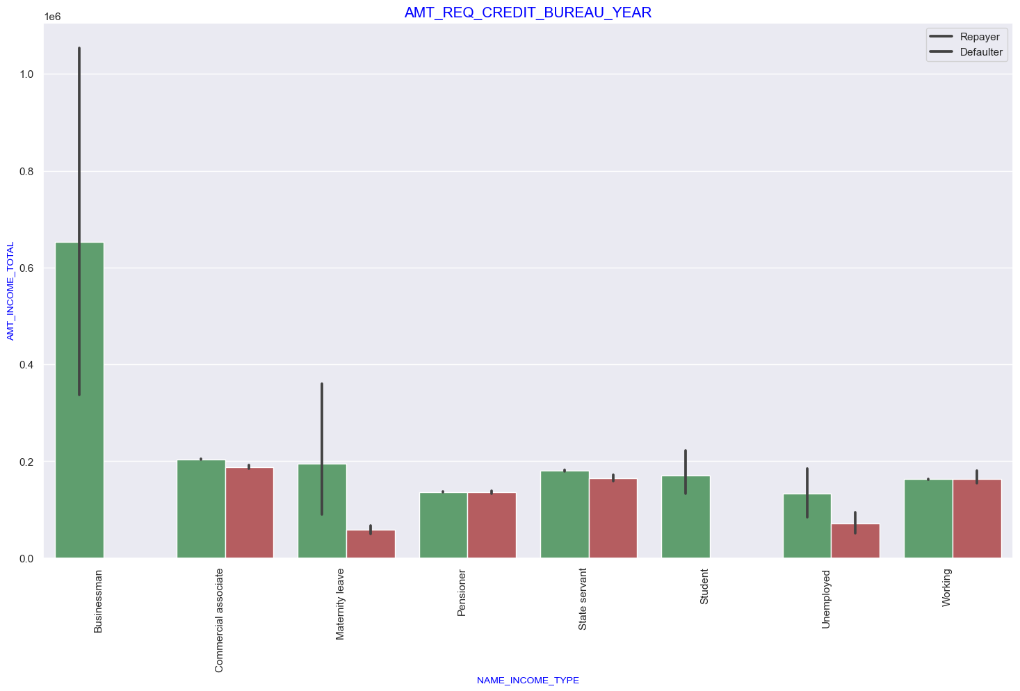
Bivariate analyis
In here , analyzed the corealtion between two independent and target variable
Income type and income total and risk of defaulting analysis shown that business man's income is the highest and the estimated range with default 95% confidence level seem to indicate that the income of a business man could be in the range of slightly close to 4 lakhs and slightly above 10 lakhs, and no risk of defaulting

Slide 28
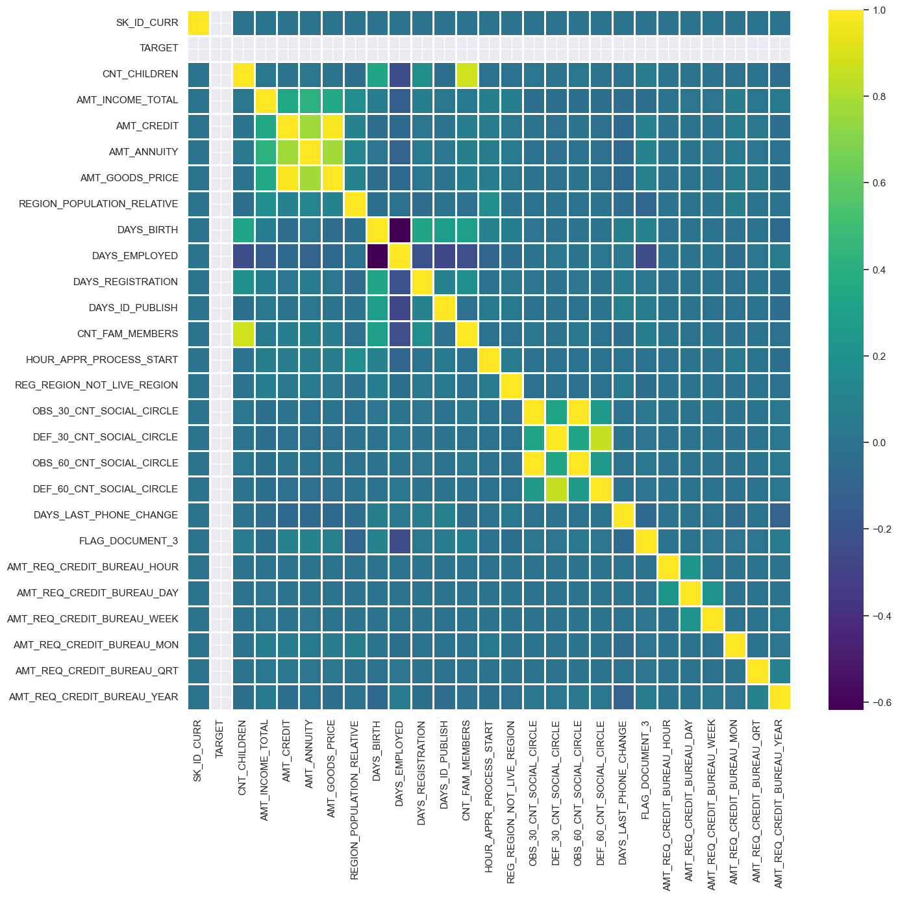
Multivariate analysis with Target variable 1)Repayer AS Target and multivariate independent
Insight:
Correlating factors amongst repayerrs: Credit amount is highly correlated with amount of goods price loan, annuity total income
We can also see that repayers have high correlation in number of days employed.

Slide 29

2)defaulter as target and multivariate independent
Inferences: Credit amount is highly correlated with amount of goods price which is same as repayers. But the loan annuity correlation with credit amount has slightly reduced in defaulters(0.75) when compared to repayers(0.77) We can also see that repayers have high correlation in number of days employed(0.62) when compared to defaulters(0.58). There is a severe drop in the correlation between total income of the client and the credit amount(0.038) amongst defaulters whereas it is 0.342 among repayers. Days_birth and number of children correlation has reduced to 0.259 in defaulters when compared to 0.337 in repayers. There is a slight increase in defaulted to observed count in social circle

Slide 30
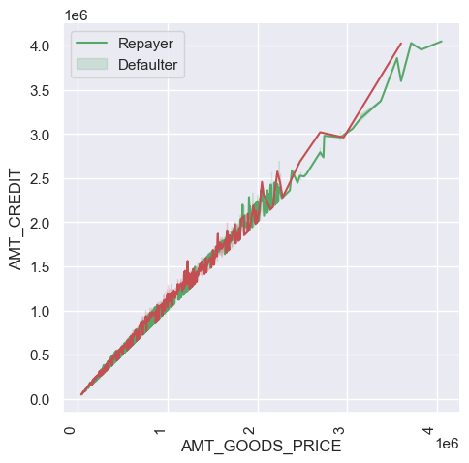
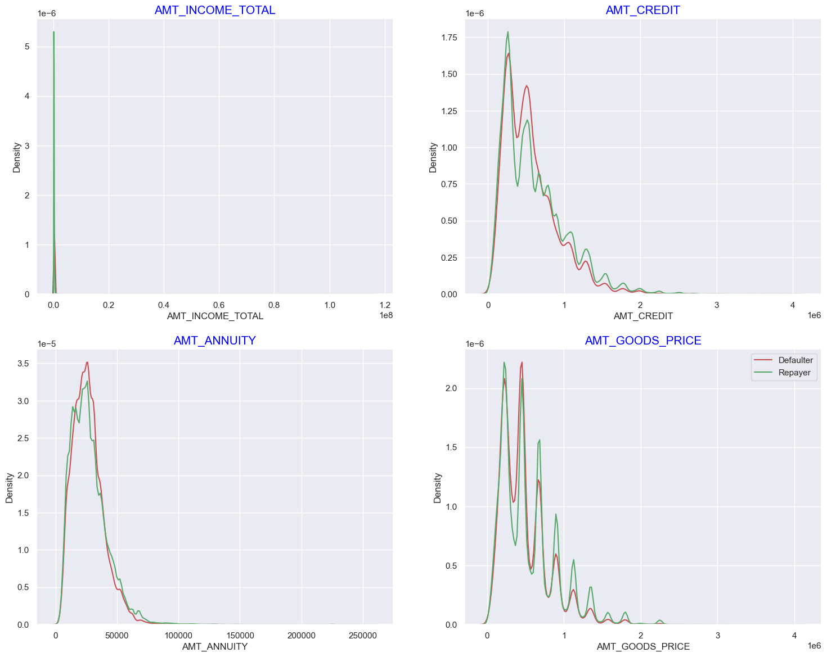
visualize the attribute in graph which have higher corelation with risk of defaulting and repayor through two distribution plot, identify distribution, comparing distribution, and detect outlier
In first plot, the people who have more than 3 million mean good price more than 30 lakh , shows straight increase in defaulters
In second subplot, shows that,
Most no of loans are given for goods price below 10 lakhs Most people pay annuity below 50000 for the credit loan Credit amount of the loan is mostly less then 10 lakhs The repayors and defaulters distribution overlap in all the plots and hence we cannot use any of these variables in isolation to make a decision

Slide 31
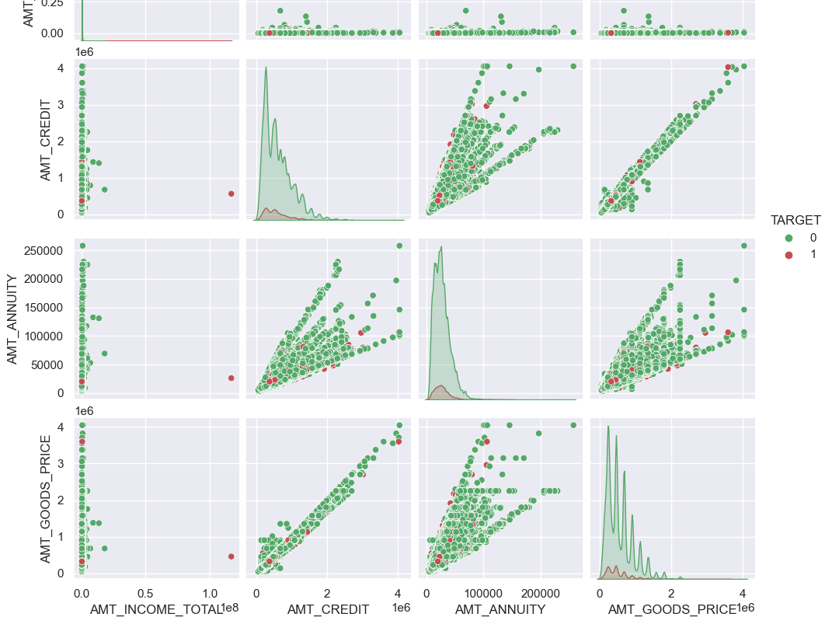
To ensure previous classification we did pairplot analysis with same variables
Insight:
When amt_annuity >10000 amt_goods_price> 0.35M, there is a greater chance of defaulters and AMT_credit greater than 3 have risk of defaulting

Slide 32
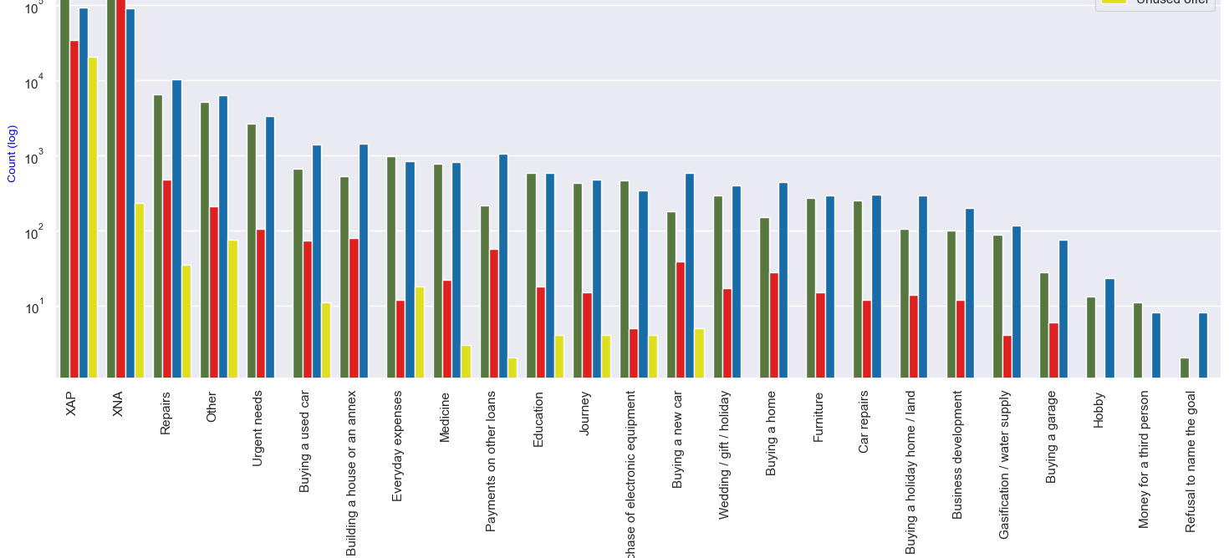
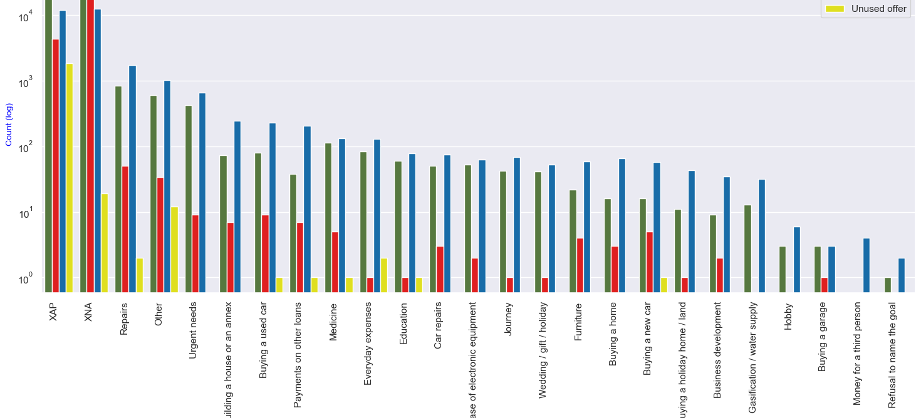
Mergeddata independent and target repayer and target defaulter relation
Purpose of loan and status
Insight:
Loan purpose has high number of unknown values (XAP, XNA) Loan taken for the purpose of Repairs seems to have highest default rate A very high number application have been rejected by bank or refused by client which has purpose as repair or other. This shows that purpose repair is taken as high risk by bank and either they are rejected, or bank offers very high loan interest rate which is not feasible by the clients, thus they refuse the loan.
In [169]:
1

Slide 33
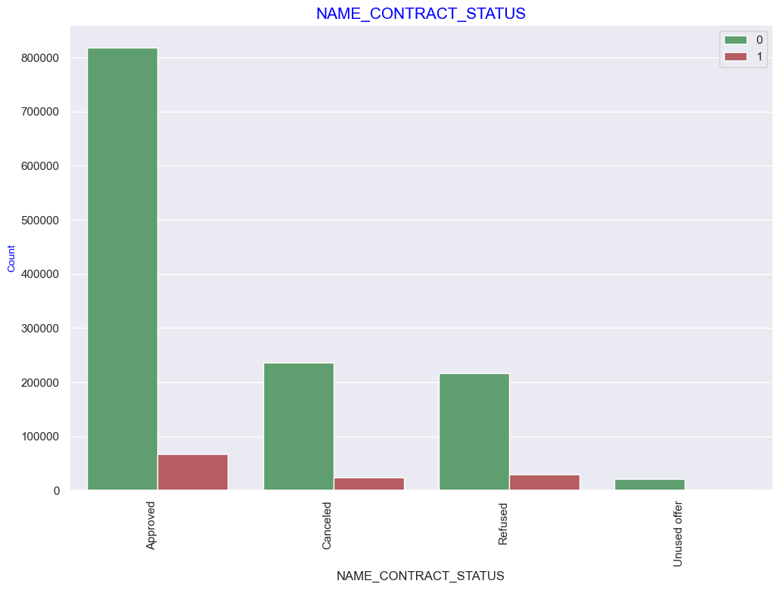
Contract status and both target variable
Insight
90% of the previously cancelled client have repaid the loan. Revisiting the interest rates would increase business opportunity for these clients 88% of the clients who have been previously refused a loan has paid back the loan in current case. Refusal reason should be recorded for further analysis as these clients would turn into potential repaying customer.

Slide 34
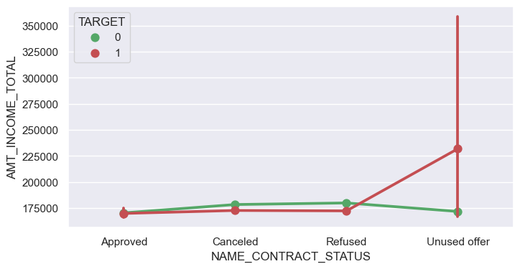
Income total and contact status with Risk default
Insight:
the people who have got unused offer are highest defaulter even the have the high income

Slide 35
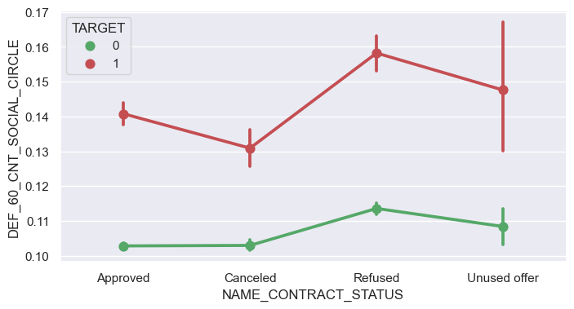
Social circle and contact status with risk of default
Insight:
Clients who have average of 0.13 or higher DEF_60_CNT_SOCIAL_CIRCLE score tend to default more and hence client's social circle ha Clients who have average of 0.13 or higher

Slide 36
Attribute resposible for higher risk
Contract type: people who take the cash loans which have higher risk of defaulter(more than 8%)
Code gender:Male have higher percentage more than 10%
Housing type: People living with parents (~11.5%) and living in rented apartments(>12%) have higher probability of defaulting
Family status: people who are civil marriage and single high risk of defaulting around10%
Education level: people who have lower education high defaulter risk represents 10% and people who competed secondary education are the 2nd highest defaulter around 8.5%
Income type: the Maternity leave person almost 40% of risk of not returning loan, followed by Unemployed (37%).
Region rating: Region Rating 3 has the highest default rate around (11%)
Occupation type: where low skills labor around (around17%) whose defaulting risk higher than the others professional people
Organization type: Industry type 8, transport type3, industry type 13 have relative high defaulting rate, shows 12 to 16%
Flsg dccument_3: applicants have submitted this document, they have defaulted a slightly more (~9%) than who have not submitted the document (6%)
people who have more than 3 million mean good price more than 30 lakh , shows straight increase in defaulters
amt_annuity >10000 amt_goods_price> 0.35M, there is a greater chance of defaulters and AMT_credit greater than 3 have risk of defaulting
Loan purpose has high number of unknown values (XAP, XNA) Loan taken for the purpose of Repairs seems to have highest default rate
the people who have got unused offer are highest defaulter even the have the high income
Clients who have average of 0.13 or higher DEF_60_CNT_SOCIAL_CIRCLE score tend to default more and hence client's social circle ha Clients who have average of 0.13 or higher

Slide 37
Attributes responsible for Good payer
Cash loan : revolving loans(around 5.5%) which represents good repayer
Code gender: female( 6%) defaulting risk, is comparatively less risk than the male
Housing type: People living in House/ apartment and office apartments have lowest default rate around 8% and around 6.2% respectively
Family status: widow and unknown status of people are lower risk less than 6%in defaulting risk
Education level: People who have high education degree are least defaulter(less than 2%)
Income type: Businessman and student are good repayer, a business man could be in the range of slightly close to 4 lakhs and slightly above 10 lakhs, and no risk of defaulting
Region rating: Applicant living in Region Rating1 (around 4.5%) has the lowest probability of defaulting, thus safer for approving loan
Occupation type: high skill tech job and Accountant less risk for defaulting(less than 5%) are good payer
Organization type: Trade Type 4 and 5 Industry lowes defaulting rate
Flag document_3: people who have not submitted the document (6%)
90% of the previously cancelled client have repaid the loan. Revisiting the interest rates would increase business opportunity for these clients 88% of the clients who have been previously refused a loan has paid back the loan in current case

Slide 38
Recoommendation
Approximately 90% of the clients who were previously classified as cancelled have successfully repaid their loans. It is important for the bank to capture the reasons behind these cancellations as they can provide valuable insights for negotiating and establishing favourable terms with these clients in the future, thereby increasing potential business opportunities.
Furthermore, out of the clients who were previously rejected by the bank for a loan, approximately 88% of them have now become repaying clients. Documenting the reasons for their initial rejection can help mitigate business losses and provide an opportunity to reach out to these clients for future loan offerings.
In summary, documenting the reasons behind client cancellations and rejections can significantly benefit the bank by enabling them to understand the factors influencing client behaviour and tailor their strategies accordingly. This proactive approach can enhance business prospects and foster better relationships with clients.

Slide 39
Thanks!
Thanks for reading

